Slide 1
WWII: Pacific Theatre

Slide 2
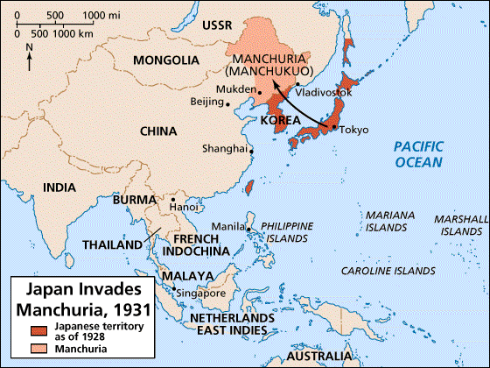
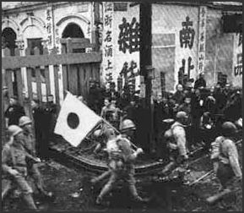
Outbreak of WWII
Japan felt disrespected after being left out of the Paris Peace Conference in 1918.
Sought to demonstrate Japan’s self-worth
1931: Japanese invasion of Manchuria
1937: Japanese invasion of China
1940: Japan joins the Axis military alliance with Germany and Italy

Slide 3
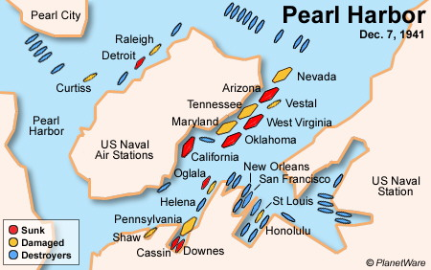
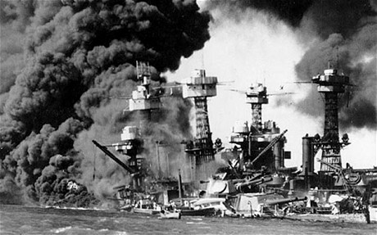
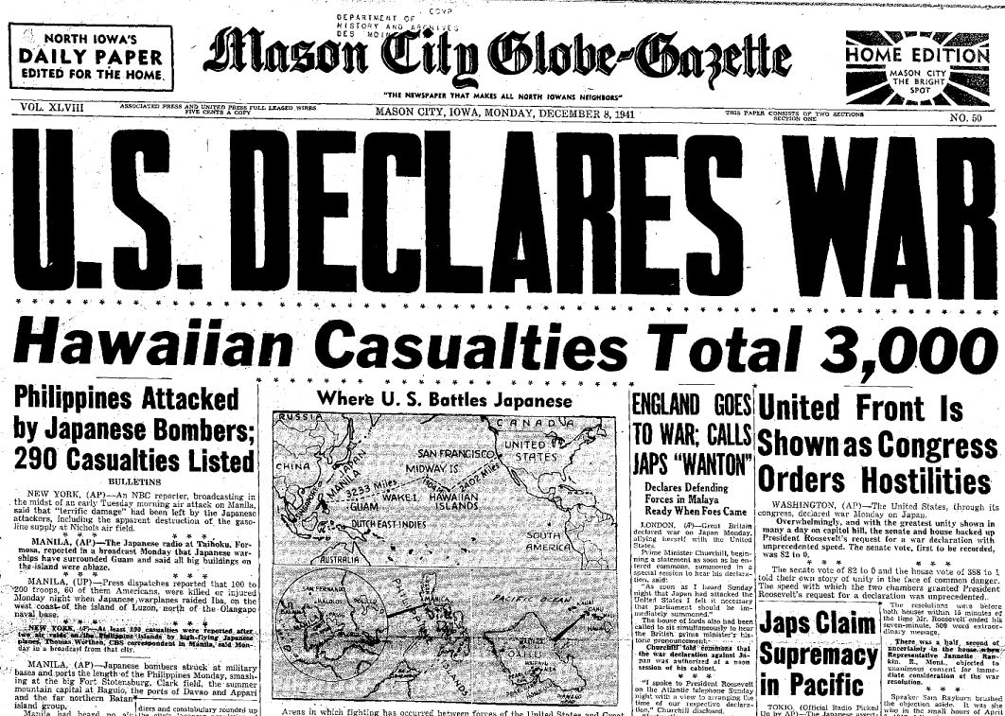
1941
The U.S. imposed economic sanctions on Japan in response to the invasions of Manchuria and China.
Japan had long sought to displace the U.S. as a dominant Pacific power.
December 7th: Japan launches surprise attack on Pearl Harbor
Used Kamikaze attacks
U.S. declares war against Japan.

Slide 4
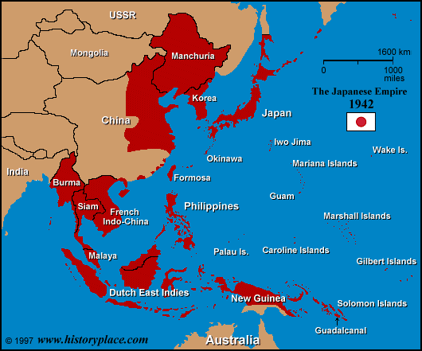
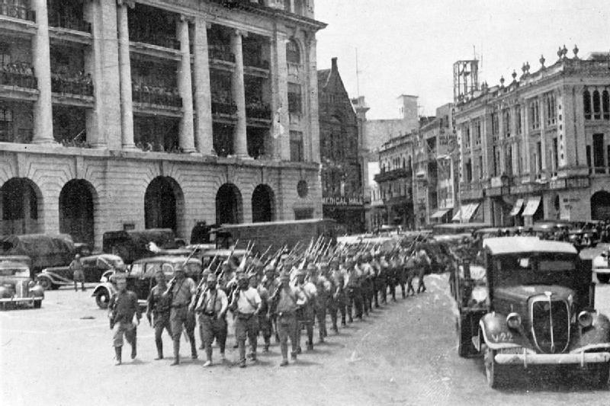
1942
Japan took Guam, Wake Island, the Philippines, the Dutch East Indies, Hong Kong, Malaya, Singapore, and Burma.
Mid-1942: Allied forces halt the Japanese advance.

Slide 5
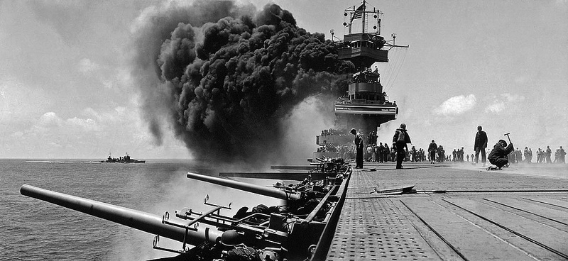
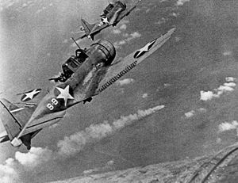
Battle of Midway
June 4th – 7th, 1942
Decisive navy battle between the U.S. and Japan in the north-central Pacific Ocean.
Outcome: Allied Victory
Significance: Turning point in the Pacific Theatre

Slide 6
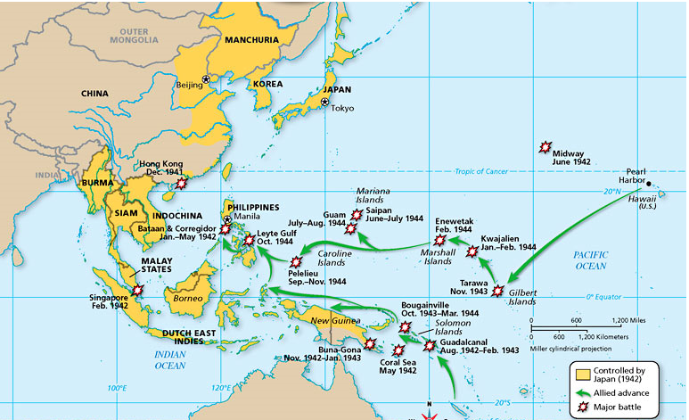
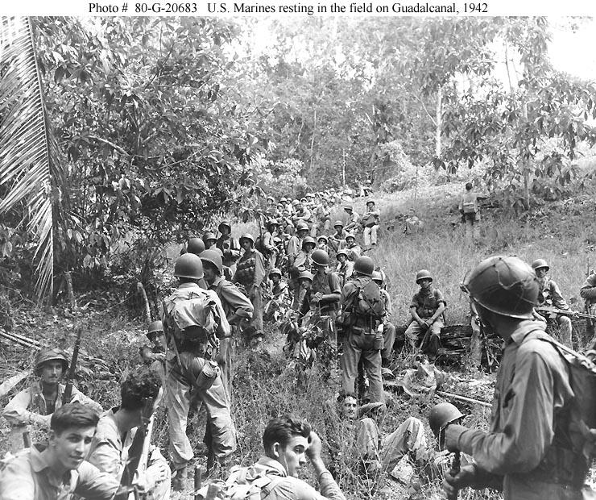
1943
Japanese forces withdraw from the island of Guadalcanal.
Allied forces gain naval and air supremacy in the Pacific.
Island-Hopping: Allied strategy of taking individual islands on their way to the Japanese mainland.

Slide 7
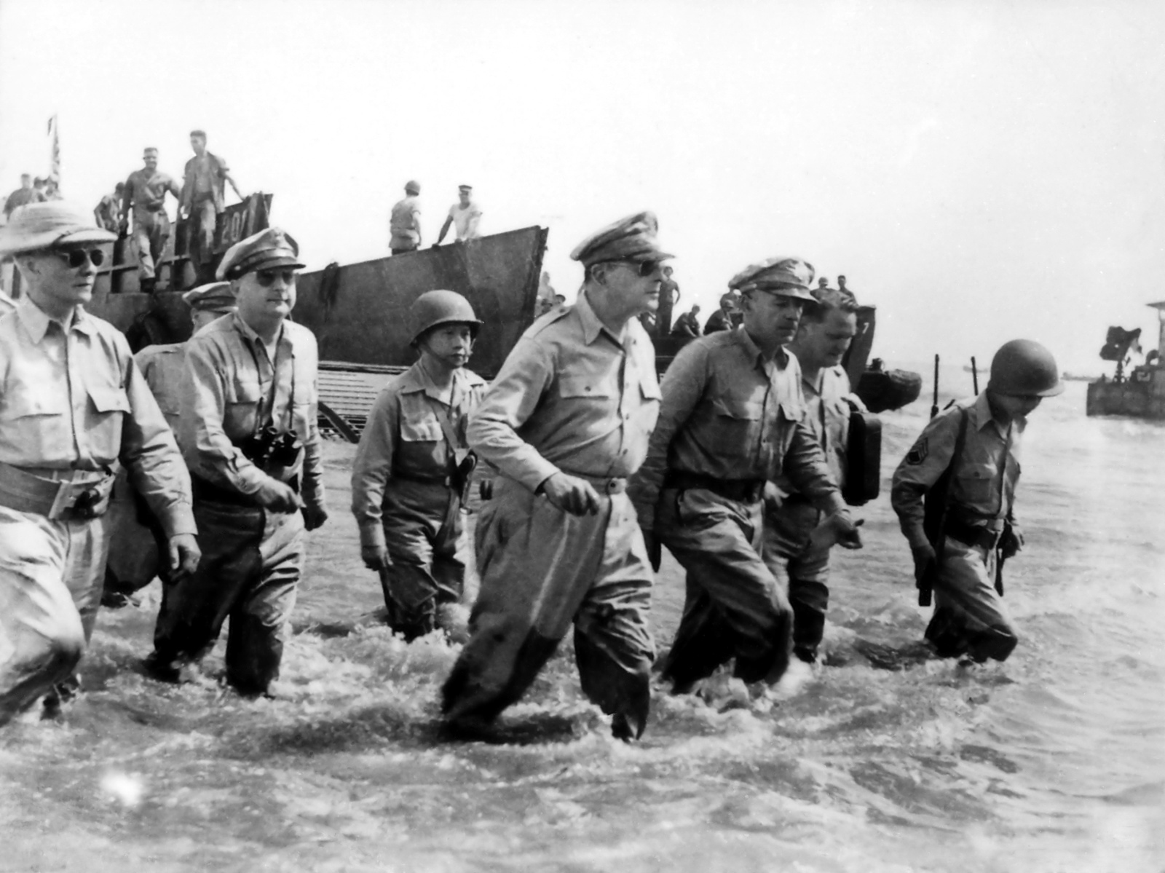
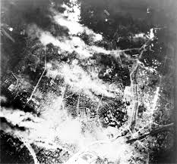
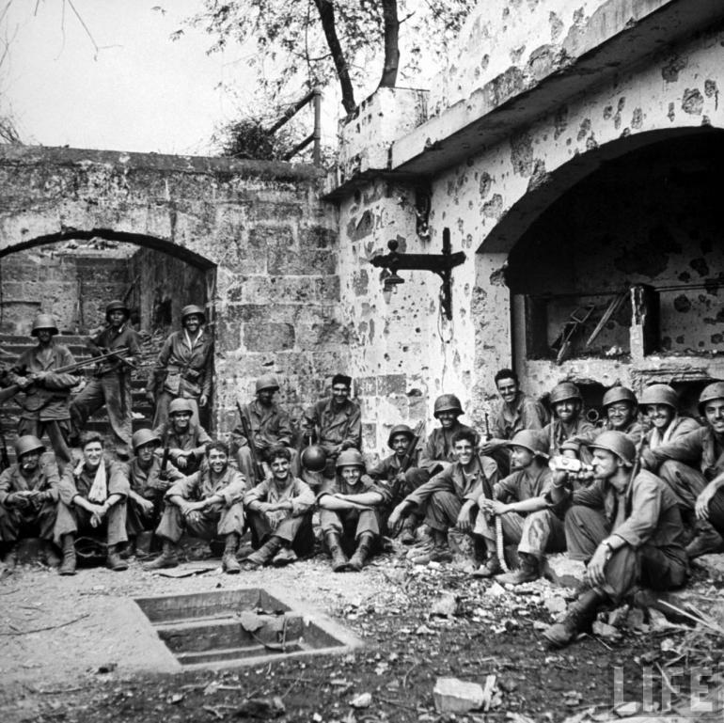
1944
American forces liberate the Philippines.
Allies carry out massive air attacks on the Japanese mainland.
Target Japanese industry

Slide 8
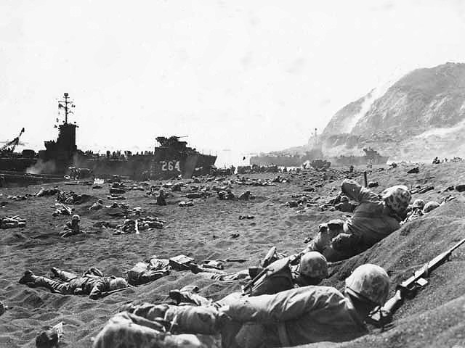
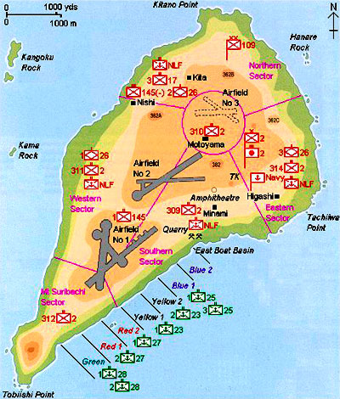
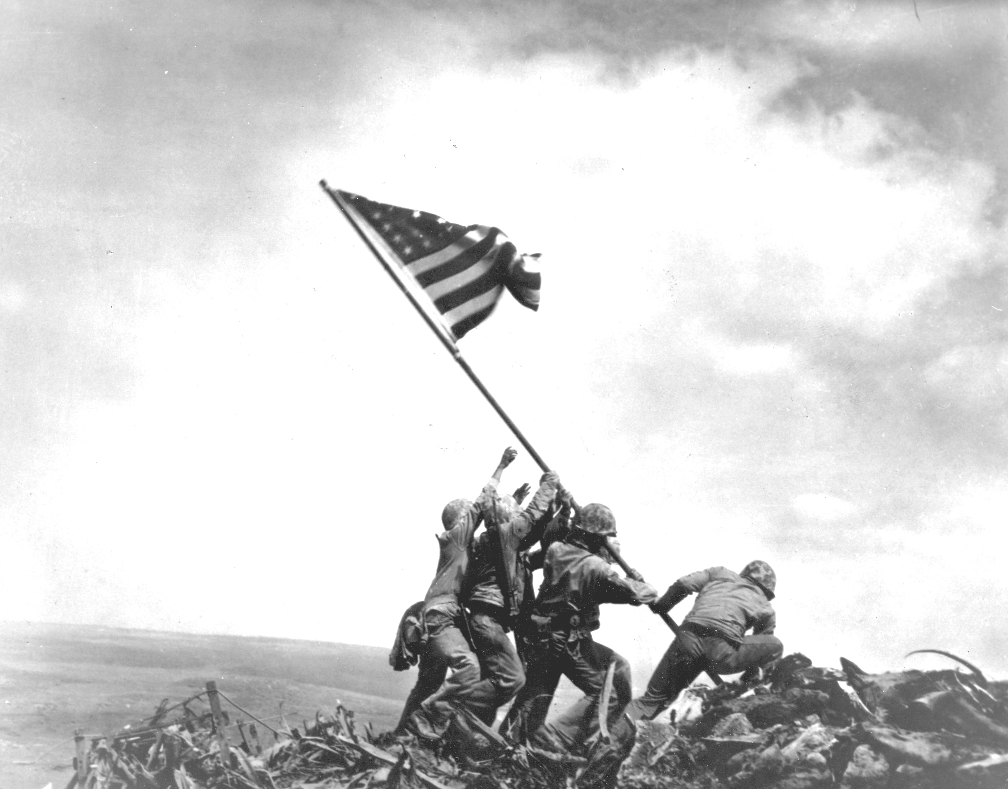
Battle of Iwo Jima
February 19th – March 26th, 1945
Amphibious invasion of a key island just off the coast of the Japanese mainland.
Outcome: Allied victory
Significance: Allies seize key airfields on the island

Slide 9
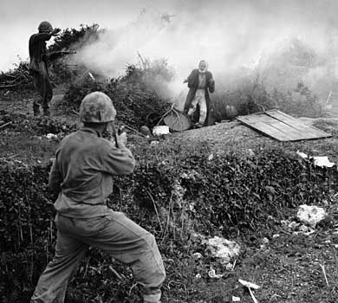
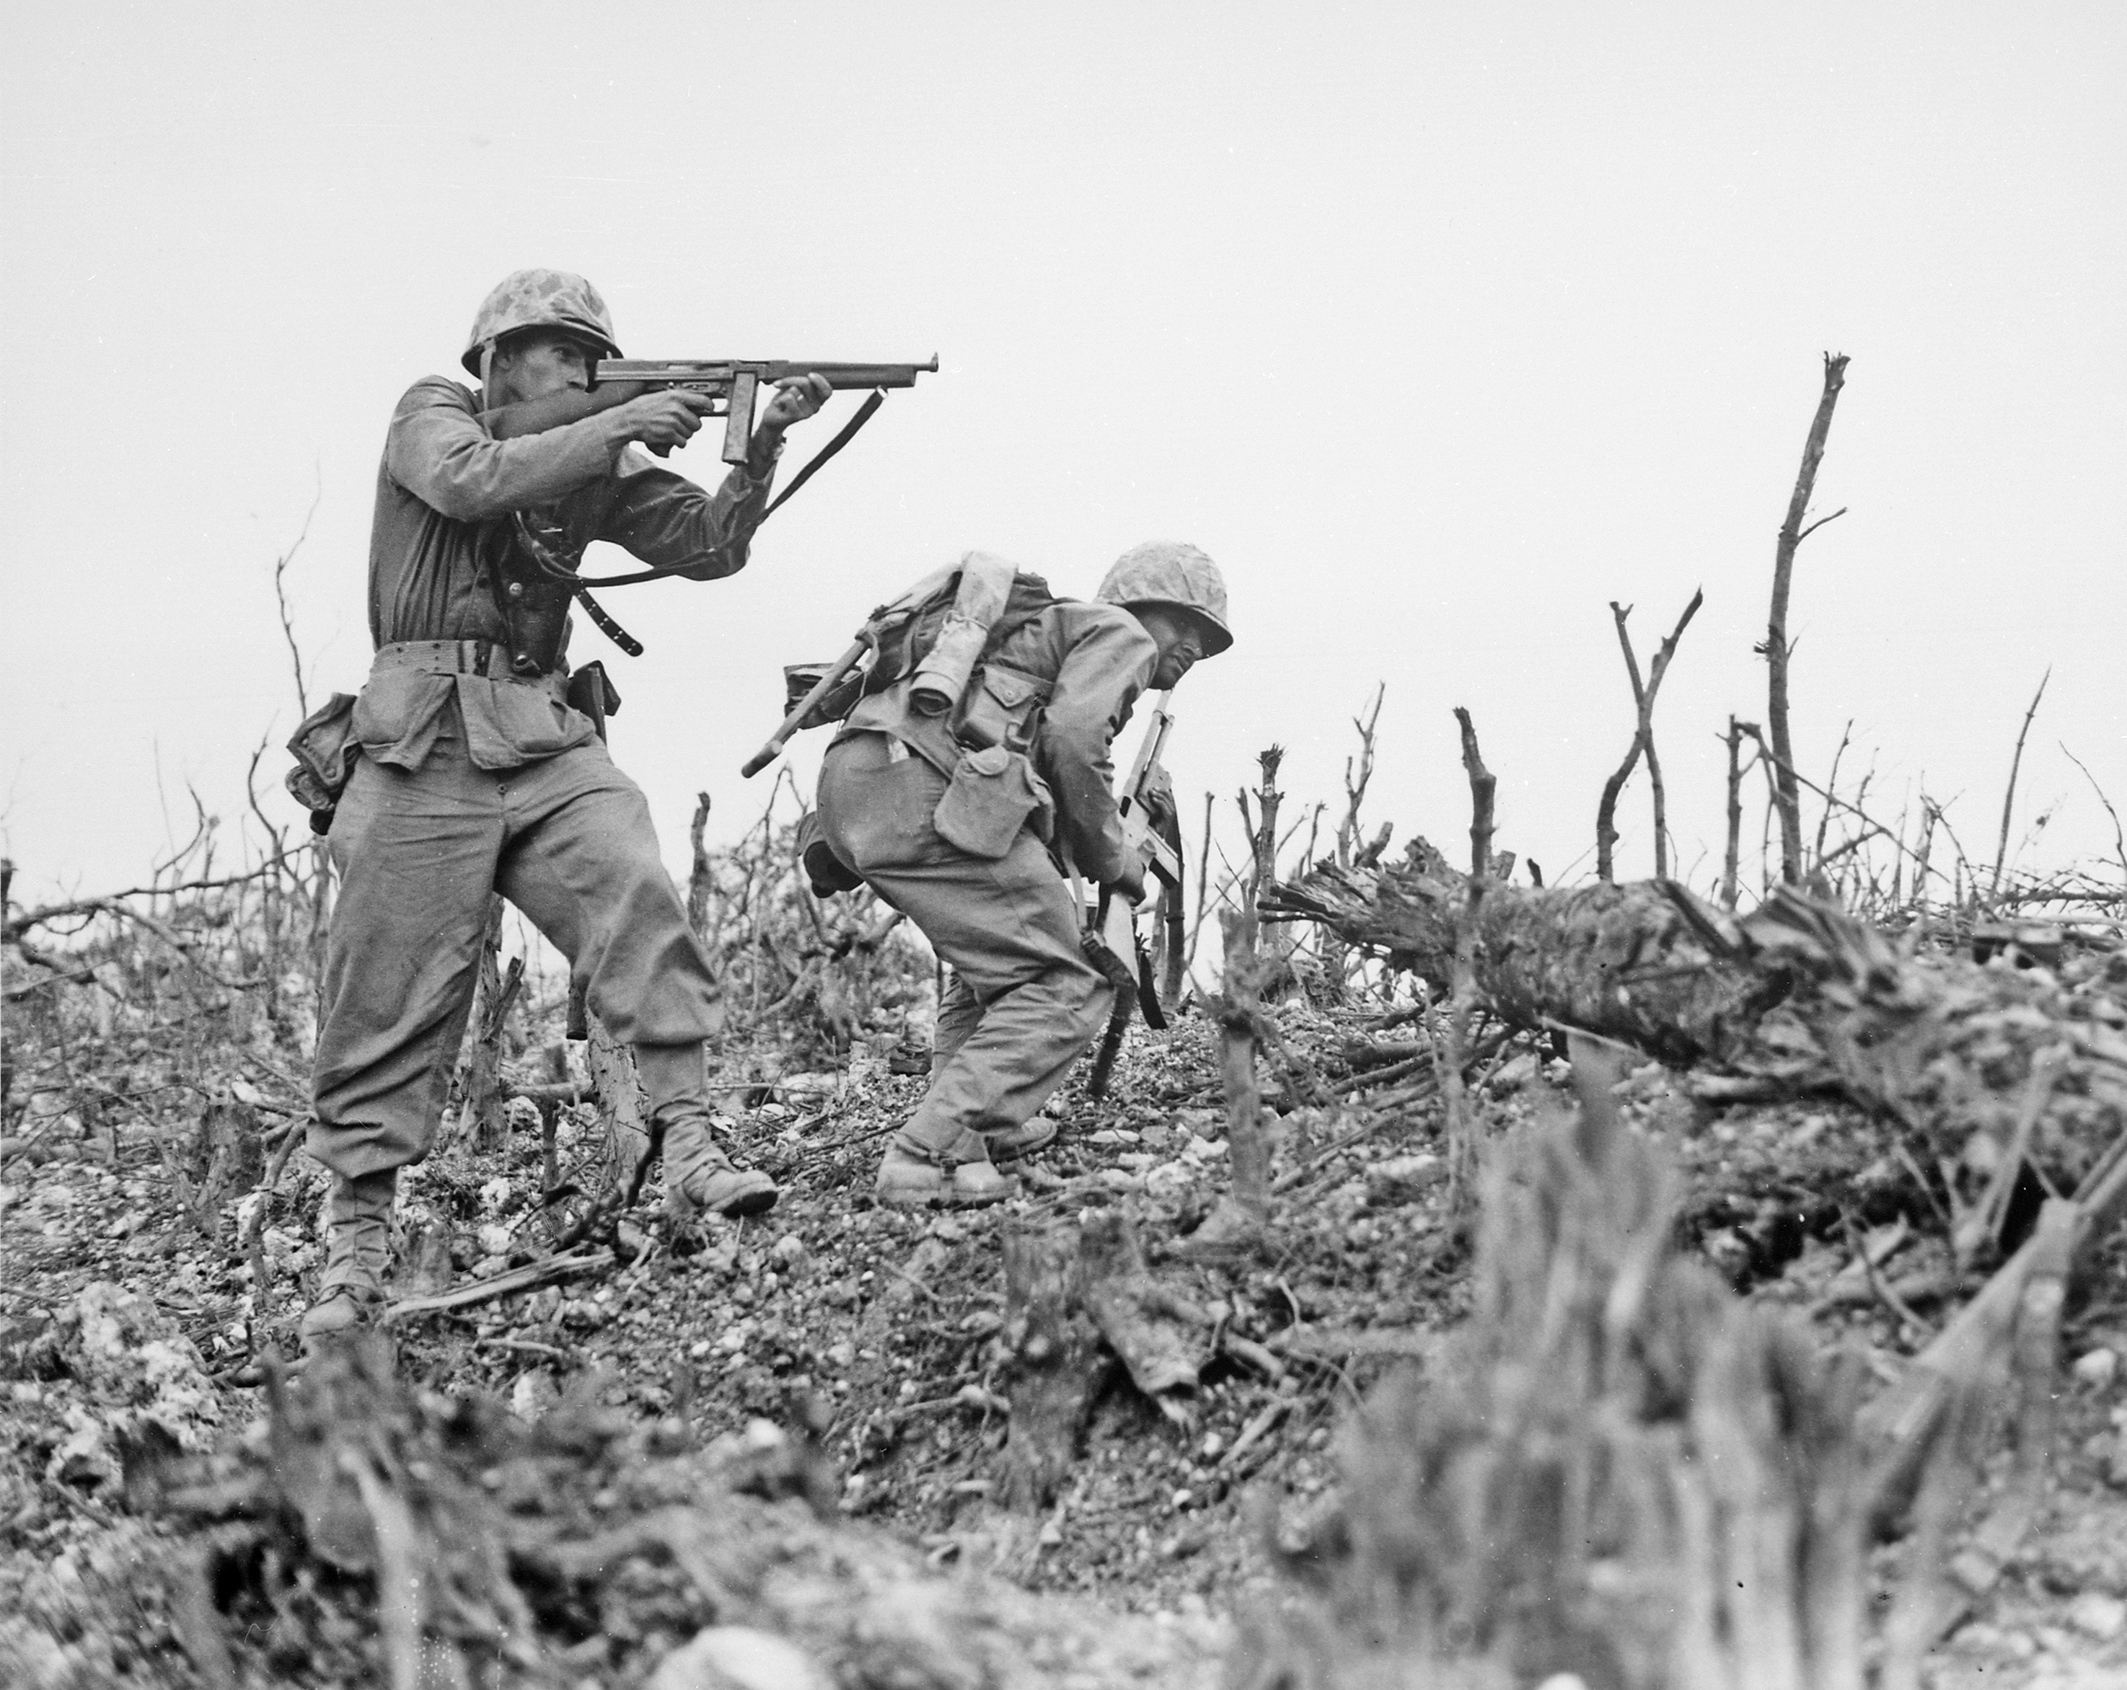
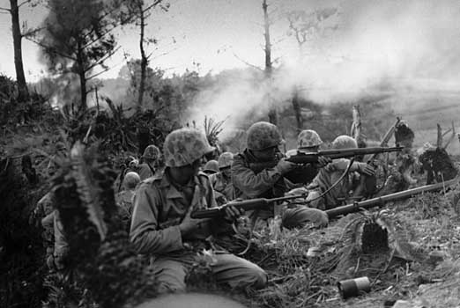
Battle of Okinawa
April 1st – June 22nd, 1945
Bloodiest battle of the Pacific Theatre.
Outcome: Allied victory
Significance: Last major battle of the Pacific Theatre.

Slide 10
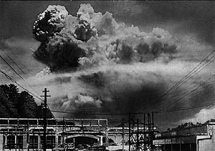
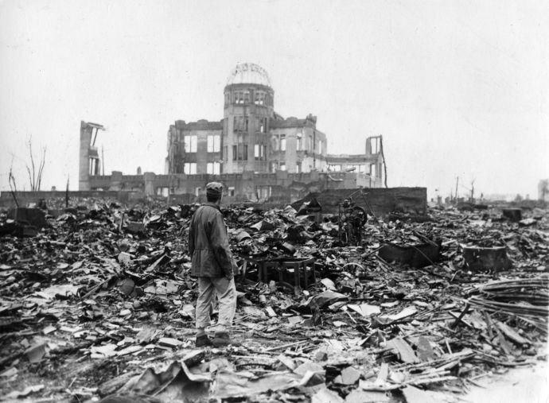
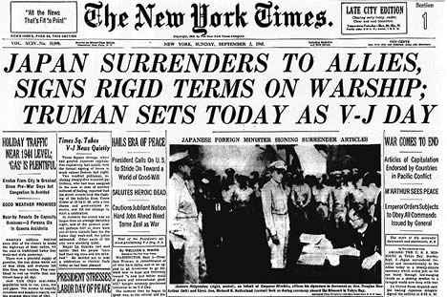
1945: End of WWII
Allies began preparing for an invasion of the Japanese mainland.
August 6th: Atomic bombing of Hiroshima.
August 9th: Atomic bombing of Nagasaki.
Total of 120,000 civilian casualties from the two bombs.
September 2nd: Japan surrenders

