Slide 1
Causes of World War II

Slide 2
Cause #1: Outcome of WWI
Treaty of Versailles forced Germany to…
Accept full blame for the war
Pay $422 billion
Disarm its military
Give up substantial amounts of land
Replace imperial government with Weimar Republic
Treaty frustrates Germans and leads to the rise of the Nazi Party

Slide 3
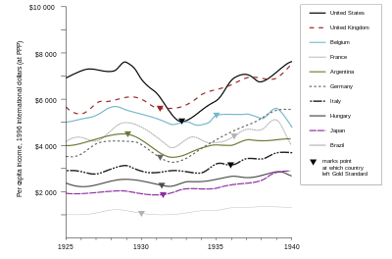
Cause #2: Global Depression
1929 through the 1930s
Caused in large part by America’s Great Depression
Germany hit especially hard by the depression.

Slide 4
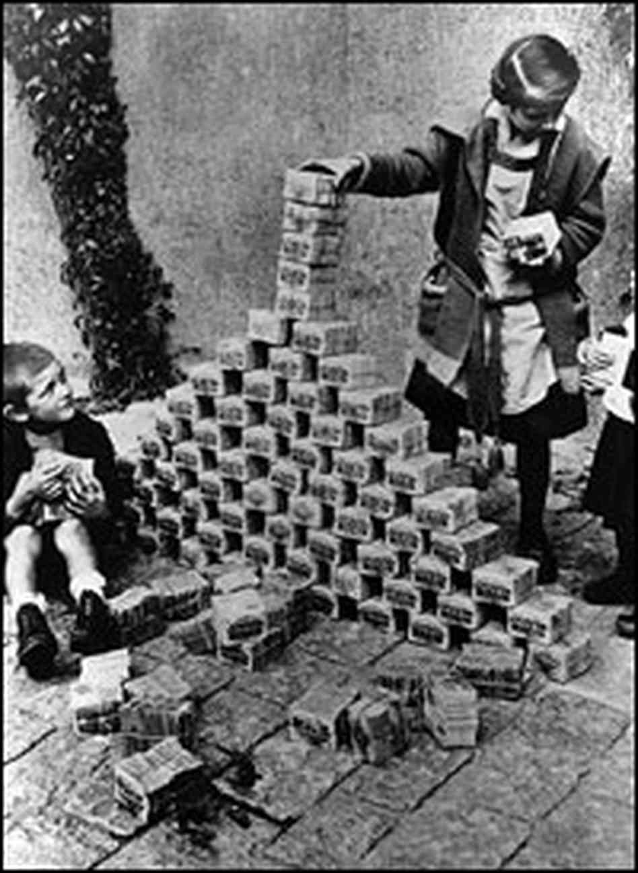
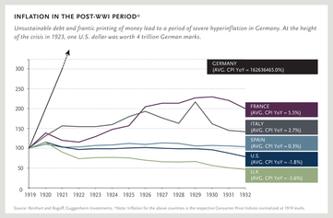
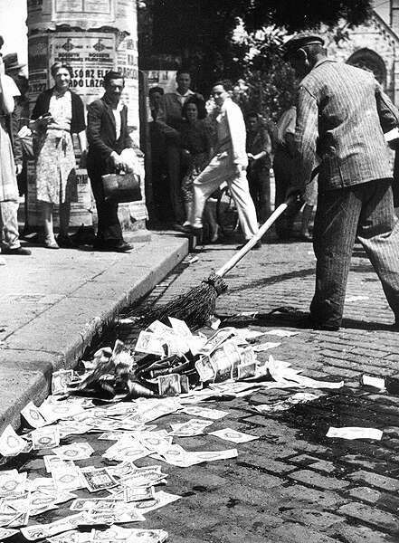
Cause #3: German Hyperinflation
Inflation definition: general level of prices for goods and services is rising, and purchasing power is falling.
Hyperinflation: extreme inflation
$1.00 = 4,210,500,000,000 German marks.
Desperate times call for desperate measures.

Slide 5
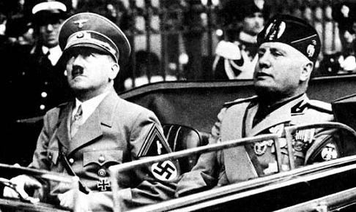
Cause #4: Fascism
Definition: a governmental system led by a dictator who has complete power, suppresses opposition, controls all industry, and emphasizes aggressive nationalism.
Strongly devoted citizens are more likely to follow the will of their leader.
Fascist dictators rise to power in Germany and Italy.
Mobilize their people towards war.

Slide 6
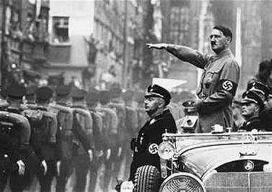
Cause #5: Totalitarianism
Definition: political system in which the state holds total authority over the society and seeks to control all aspects of public and private life.
Led by an authoritarian who maintains strict control over their country.
Example: Nazi Germany, Fascist Italy, Communist USSR

Slide 7
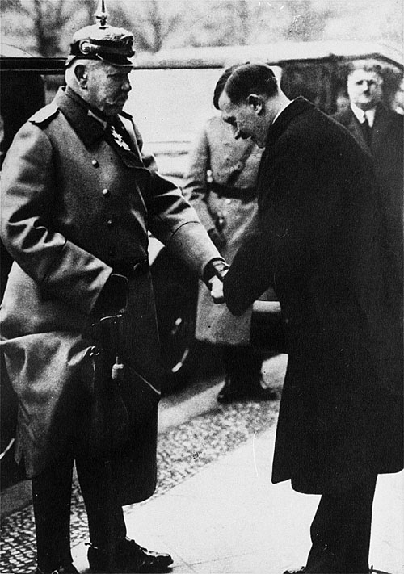
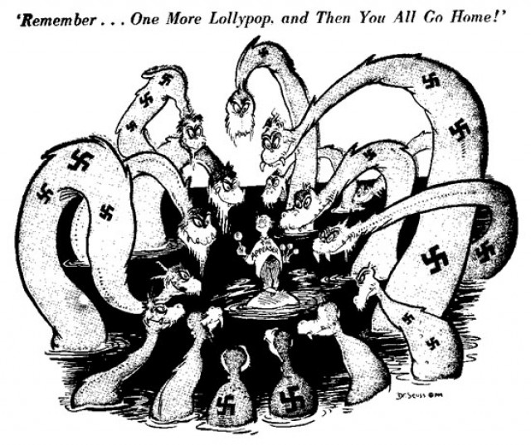
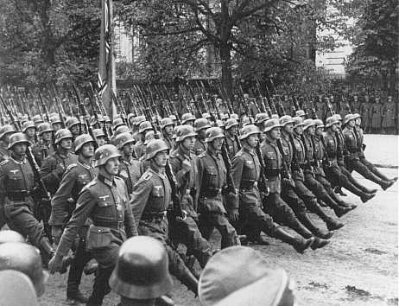
Lead up to War
1933: Hitler appointed chancellor of Germany
1937-1939: Appeasement
Western Europe’s policy to give Hitler what he wanted so as to avoid war
1939: Germany invades Poland

Slide 8
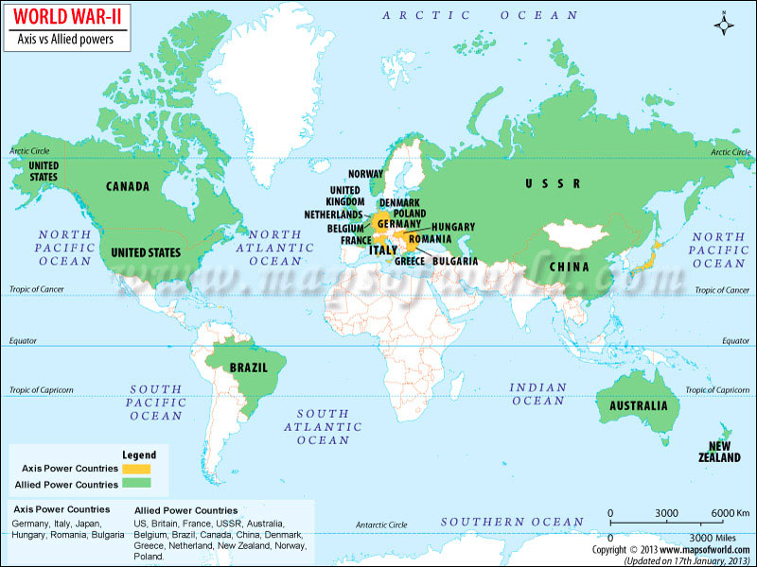
World War II
1939-1945
Axis | Allies
Germany – Adolf Hitler Italy – Benito Mussolini Japan – Emperor Hirohito | United States – Franklin D. Roosevelt Great Britain – Winston Churchill Soviet Union – Joseph Stalin

