Slide 1
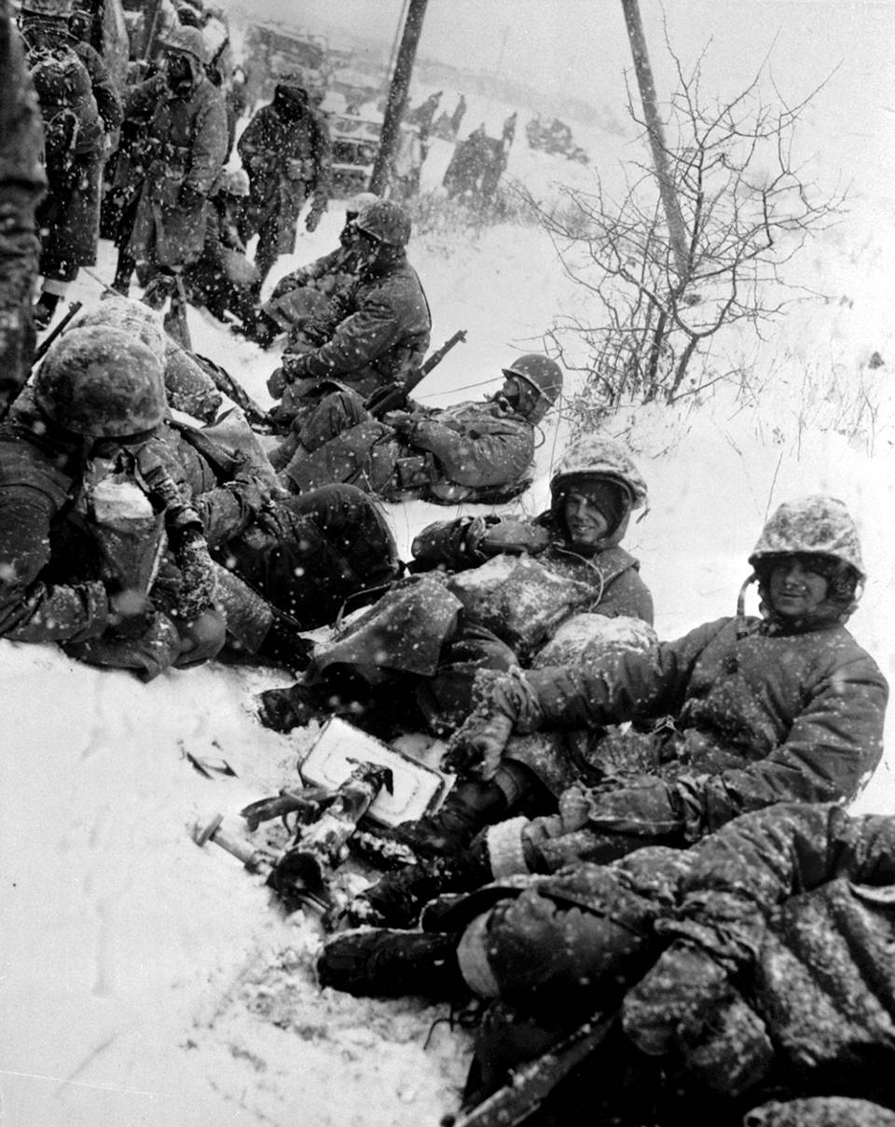
Intro to the Cold War
Dude… its cold.

Slide 2
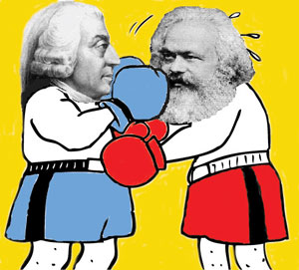
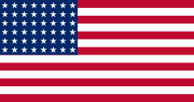
Communism vs. Capitalism
Communism
Government controlled all property/economic activity
Only one political party – Communist
Capitalism
Citizens control property/economic activity
Citizens elect officials from competing parties

Slide 3
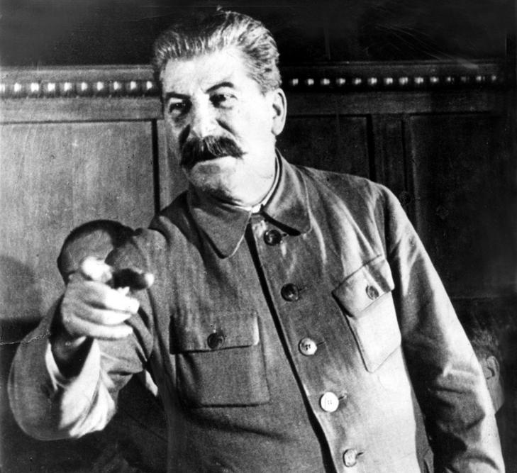
Stalin and Communists are not Happy!
Why didn’t the U.S. attack Germany sooner?!?!?
The U.S. had an atomic bomb?!?!?

Slide 4
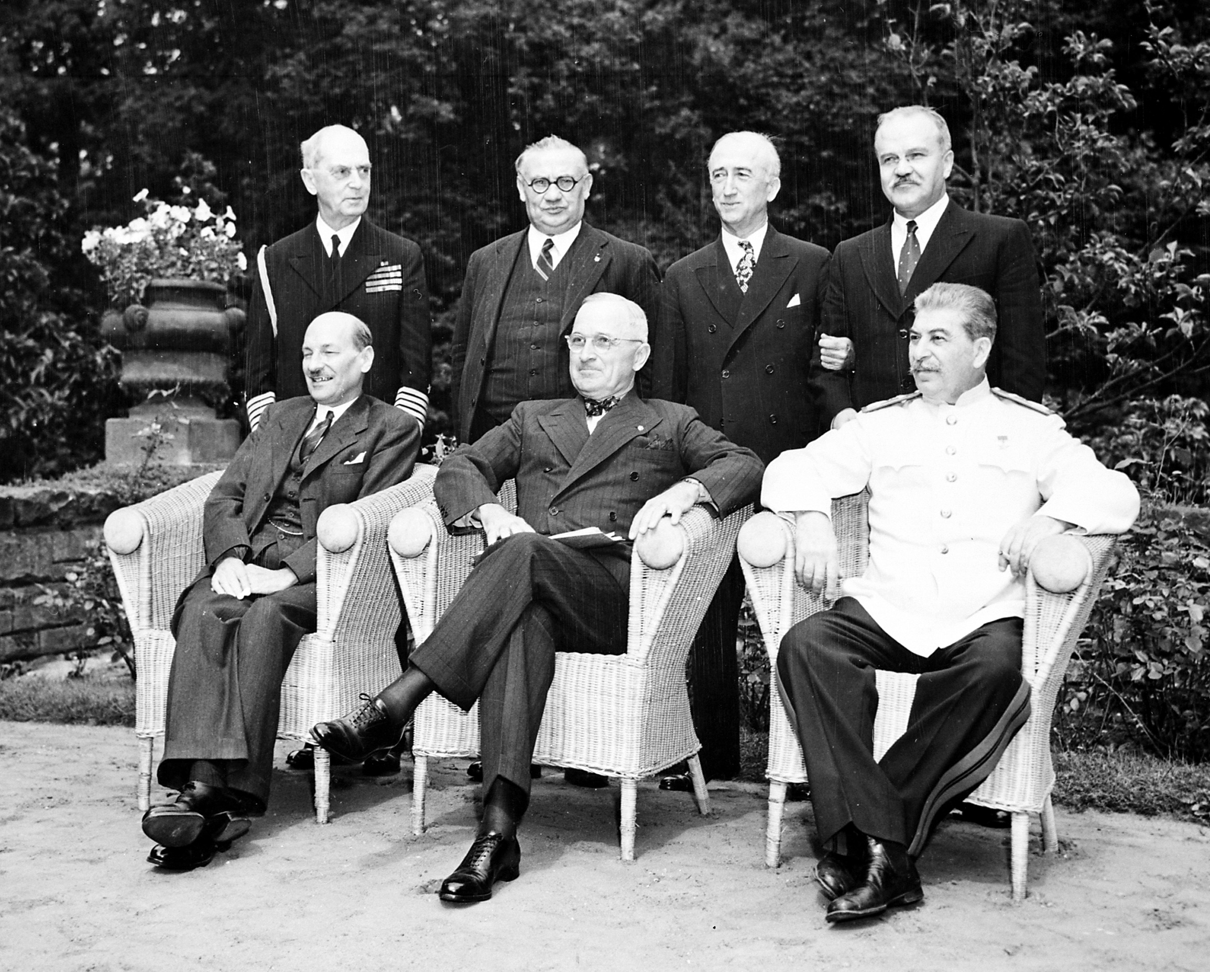
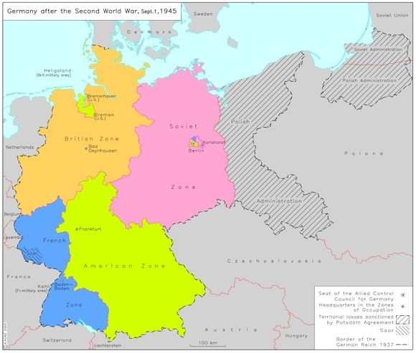
Potsdam Conference
Conference to decide the fate of Germany after WWII
Allied victors come to a ruling:
Germany must demilitarize and separate into 4 zones

Slide 5
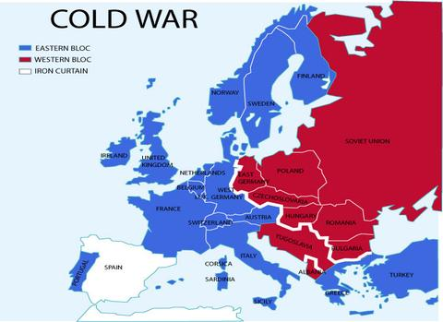
Containment
Eastern Europe = Communist
Western Europe = Democratic
Democratic powers race to prevent the spread of Communism
Winston Churchill
“Iron Curtain” between East & West

Slide 6
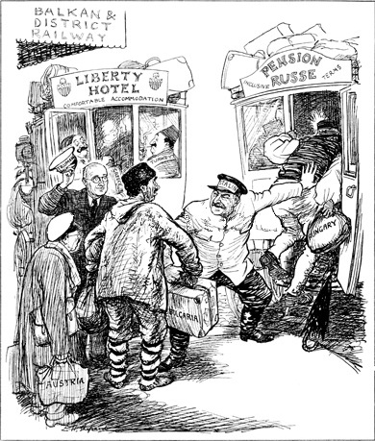
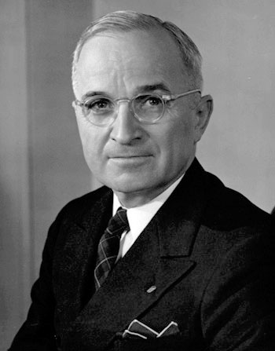
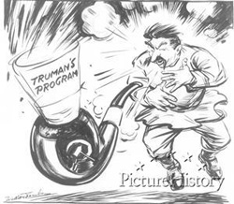
Truman Doctrine
U.S. policy designed to prevent the spread of Communism
U.S. would support any country resisting Communism
Congress gave $40 million to help Greece and Turkey

Slide 7
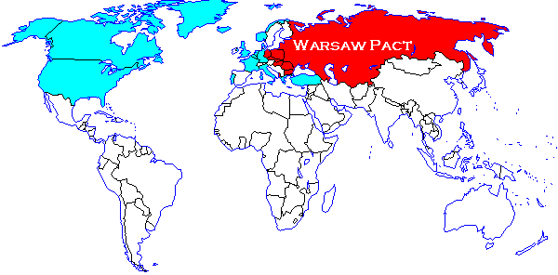
NATO and the Warsaw Pact
The two sides form opposing alliances:
NATO: alliance group formed to counter Soviet expansion by fighting to contain communism
Warsaw Pact: military alliance of the Soviet Union and its satellite states
These alliances further divided the two sides and created more tension

