Slide 1
The Shadow of war
The Roots of American Involvement in WWII

Slide 2
FDR’s Domestic Focus
America’s withdrawal from the London Economic Conference
Freedom for the Philippines
Tydings-McDuffie Act
FDR’s recognizes the USSR
Notes:
FDR is more concerned with America’s recovery than with international cooperation. He decides not to go to a conference that while helping to prevent further global economic decline might hinder America's chance at recovery. This only encouraged European dictators.
FDR and most Americans agree that they can no longer afford to administer the Philippines. The Tydings-McDuffie Act promised the Filipinos their freedom by 1946. More because the US was interested in their own well being than in what was best for the Filipinos. Evidenced by the unfair economic terms that were imposed upon American withdrawal.
Interested in trade with the Soviets, FDR make the unpopular decision to recognize the USSR as a legitimate nation.

Slide 3
Being a Good Neighbor
Good Neighbor Policy
Reversal in relations with Latin America. FDR repealed:
Roosevelt Corollary
Marines out of Haiti
Platt Amendment
Kept Guantanamo
Drastically improved US relations with Latin America
Notes:
The Good Neighbor policy was the foreign policy of the administration of United States President Franklin Roosevelt toward the countries of Latin America. The United States wished to have good relations with its neighbors, especially at a time when conflicts were beginning to rise once again, and this policy was more or less intended to garner Latin American support. Giving up unpopular military intervention, the United States shifted to other methods to maintain its influence in Latin America: Pan-Americanism, support for strong local leaders, the training of national guards, economic and cultural penetration, Export-Import Bank loans, financial supervision, and political subversion. The Good Neighbor Policy meant that the United States would keep its eye on Latin America in a more peaceful tone. On March 4, 1933, Roosevelt stated during his inaugural address that: "In the field of world policy I would dedicate this nation to the policy of the good neighbor--the neighbor who resolutely respects himself and, because he does so, respects the rights of others." This position was affirmed by Cordell Hull, Roosevelt's Secretary of State at a conference of American states in Montevideo in December 1933. Hull said: "No country has the right to intervene in the internal or external affairs of another“. This is apparent when in December of the same year Roosevelt again gave verbal evidence of a shift in U.S. policy in the region when he stated: "The definite policy of the United States from now on is one opposed to armed intervention."

Slide 4
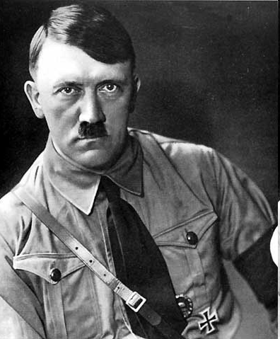
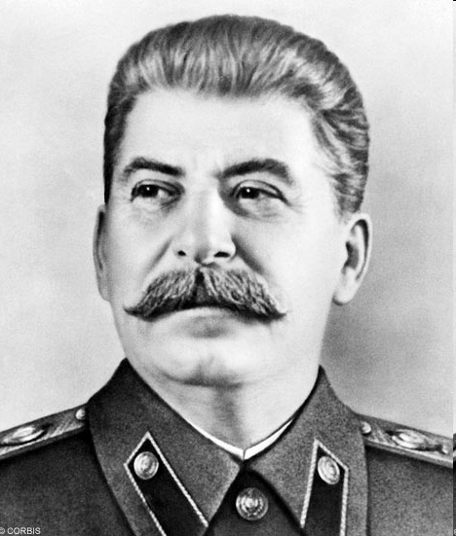
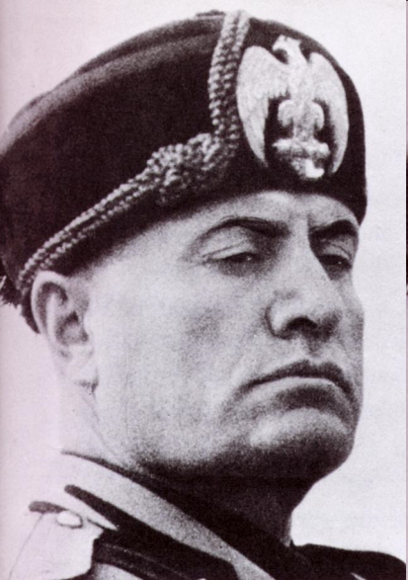
Spread of Totalitarianism
Hitler, Stalin, Mussolini
Germany, USSR, Italy
Long term impact of the Treaty of Versailles
Germany leaves the League/Italy attacks Ethiopia/Japan leaves the League
Tripartite Pact
American Isolationism
Notes:
The three nations agreed that for the next ten years they would "stand by and co-operate with one another in... their prime purpose to establish and maintain a new order of things... to promote the mutual prosperity and welfare of the peoples concerned." They recognized each other's spheres of interest and undertook "to assist one another with all political, economic and military means when one of the three contracting powers is attacked" by a country not already involved in the war, excluding the Soviet Union.
The pact supplemented the Anti-Comintern Pact of 1936 and helped overcome the rift that had developed between Japan and Germany following the Molotov-Ribbentrop Pact signed by Germany and the Soviet Union in 1939.
The Tripartite Pact was subsequently joined by Hungary (November 20, 1940), by Romania (November 23, 1940), by Slovakia (November 24, 1940), by Bulgaria (March 1, 1941, prior to the arrival of German troops), by Yugoslavia (March 25, 1941) and by Croatia (June 15, 1941).

Slide 5
Staying out of war…
“Head in the Sand” diplomacy
US involvement in WWI blamed on “economic greed”
Neutrality Acts
No concern about freedom of the seas
Limited American involvement in European Wars
Shortsighted?
Notes:
Dr. Seuss cartoons.

Slide 6
Appeasement
FDR’s “quarantine” speech
Munich Conference
Hitler’s territorial aspirations
The Sudetenland
Czechoslovakia
Poland
German-Soviet non-aggression Pact
Notes:
The Quarantine Speech was given by U.S. President Franklin Delano Roosevelt on October 5, 1937 in Chicago, calling for an international "quarantine of the aggressor nations" as an alternative to the political climate of American neutrality and isolationism that was prevalent at the time. The speech intensified America's isolationist mood, causing protest by isolationists and foes to intervention. No countries were directly mentioned in the speech, but it was interpreted as referring to Japan, Italy, and Germany.[1] Roosevelt suggested the use of economic pressure, a forceful response, but less direct than outright aggression.
Public response to the speech was mixed. It was heavily criticized by Hearst-owned newspapers and Robert R. McCormick of the Chicago Tribune, but several subsequent compendia of editorials showed overall approval in US media
The Munich Pact (Czech: Mnichovská dohoda; Slovak: Mníchovská dohoda; German: Münchner Abkommen; French: Accords de Munich; Italian: Accordi di Monaco) was an agreement permitting Nazi German annexation of Czechoslovakia's Sudetenland. The Sudetenland were areas along borders of Czechoslovakia, mainly inhabited by ethnic Germans. The agreement was negotiated at a conference held in Munich, Germany, among the major powers of Europe without the presence of Czechoslovakia. Today, it is widely regarded as a failed act of appeasement against Nazi Germany.
titled the Treaty of Non-Aggression between Germany and the Union of Soviet Socialist Republics[1] and signed in Moscow in the early hours of 24 August 1939 (but dated 23 August).[2] It was a non-aggression pact between the two countries and pledged neutrality by either party if the other were attacked by a third party. It remained in effect until 22 June 1941 when Germany implemented Operation Barbarossa, invading the Soviet Union.
In addition to stipulations of non-aggression, the treaty included a secret protocol dividing Northern and Eastern Europe into German and Soviet spheres of influence, anticipating potential "territorial and political rearrangements" of these countries. Thereafter, Germany and the Soviet Union invaded their respective sides of Poland, dividing the country between them. Part of eastern Finland was annexed by the Soviet Union after the Winter War. This was followed by Soviet annexations of Estonia, Latvia, Lithuania and eastern and northern Romania.

Slide 7
A precarious neutrality
Neutrality Act of 1939
Why “Cash and Carry?”
How did the start of WWII affect the American economy?
Why?
Notes:
Hoping to avoid being dragged into another conflict like the Great War, the US made a more defensible attempt to remain neutral—cash and carry. Though this was again a veiled and precarious neutrality, it allowed the US to trade with the European democracies it supported while not as clearly taking sides. Cash and Carry required that trade partners pay in full for all purchases and that they ship it themselves. No more American ships in the war zone like WWI.
The WWII demand for supplies was a boon to the American economy. Unemployment rates decreased steadily for the first few years of the war.

Slide 8
WWII Begins
What was the ‘phony war?’
Poland, Denmark, Norway, Belgium…FRANCE!
Why was the fall of France significant?
Notes:
Up until the fall of France, America had not been too worried about the Nazis. When France fell, Americans realized that Great Britain was all that stood between Hitler and world domination.

Slide 9
The end of the two-term precedent…
FDR seeks and wins a third term in 1940
Why were some opposed to FDR seeking a third term?
Why did he end up winning by a landslide?
Notes:
Many believed that FDR was becoming too powerful; a monarch of sorts. This sentiment in clearly represented in the cartoon.

Slide 10
The end of neutrality?
What was the Lend-Lease Act or 1940?
Was the passage of the Lend-Lease Act the equivalent of an American declaration of war?
What impact did the Lend-Lease Act have on WWII?
Notes:
The Lend-Lease Act was an act of Congress that allowed the United States to provide the allied nations with war materials. This act put to rest any pretense that the United States was neutral.

Slide 11
Unlikely Allies
Hitler invades the USSR
consequences?
What was the Atlantic Charter?
Significance?
Who liked it?
Who disliked it?
By fall of 1941, US destroyers are clashing with Nazi U-boats.
Notes:
United States begins supporting USSR under Lend-Lease.
Agreement made between FDR and Churchill – status of conquered territories after Germany was defeated → self determination.
Liberals liked it – called for a new League of Nations and self-determination
Isolationists hated it – why was the US getting involved? The US was no longer neutral.

Slide 12
12/7/41 – “A day that will live in infamy.”
Notes:
U.S. stopped exporting oil to Japan in the summer of 1941. As a result Japan was preparing to move on the Dutch East Indies which was an oil rich area. To prevent this, FDR ordered a military buildup in the Philippines and moved the U.S. Naval fleet from San Diego to Hawaii. Japan’s attack on Pearl Harbor was an attempt to neutralize American naval forces in the South Pacific so that they might proceed with their planned invasion of the Dutch East Indies.
The attack on Pearl Harbor shifted American public opinion about the war dramatically. War was declared on Japan the next day and on Germany by December 11th. The United States had officially entered WWII.

Slide 13
WWII Battles
Dates, Outcome/Details,
Overall Significance

Slide 14
Battle at Midway June 1942
Allied Victory.
First major Japanese defeat as American planes sank 4 Japanese aircraft carriers and 300+ planes.
Major naval victory, fought by Aircraft.
Stopped Japanese Naval offensive – IJN could not ever fully recover.

Slide 15
Stalingrad Aug. 1942-Jan. 1943
Russian victory.
Germans caught in Russian Winter.
Stalin ordered that the city be defended at all costs.
Most of the city destroyed, 330, 000 Germans killed.
Turning point in the Eastern theater.
Stalled Hitler’s Operation Barbarossa.
Russia went on the offensive.

Slide 16
Military Strategy – Convoy system
Used during the Battle of the Atlantic
American ships were being sunk by Germans
Convoy system set up – Cargo ships traveled in groups and were escorted by navy warships
Made it more difficult for a submarine to target a cargo ship and escape without being attacked

Slide 17
Military Strategy – Germany 1st Campaign
Agreed on by Churchill and FDR at the Casablanca Conference
Goal: Bomb Germany to destroy military, industrial and economic systems, destroy morale
Destroyed aircraft factories, wrecked railroads, and caused oil shortages

Slide 18
Fighting in Italy July 1943-End of the War
Allied victory
Led by General Patton
Italy withdraws from the war and joined the Allies side.
Huge losses on both sides. Germany defended Italy and fought ferociously.
Italy withdraws and Mussolini was killed.
Germany fought hard in Italy and had huge losses with 500, 000 Germans killed.
Allies had 300, 000 killed.
Bloody fighting.

Slide 19
D-Day June 6, 1944-July 1944
Allied victory in the re-invasion of France.
Invasion took place at Normandy, France.
Known also as Operation Overlord.
Commanded by Dwight Eisenhower
Had to have good weather conditions so paratroopers would land behind enemy lines
Turning point in the West.
Opened up a new front in the War.
France was soon liberated; beginning of the end for Axis powers.

Slide 20
Battle of the Bulge
December 1944 - January 1945
Allied victory in the end
Last major counteroffensive by the Germans
Lasted 6weeks
Hitler focused all forces on one area of the allied lines – created a huge bulge in the line
Germans last stand!

Slide 21
On to Japan!
Hitler Commits suicide on April 30th 1945
With the unconditional surrender of Germany on May 8 1945, the allies focused their attention on the Pacific Theater.
The Japanese, unwilling to surrender unconditionally, continued to fight.
The US decides to drop 2 A-bombs on two major Japanese cities. One on Aug. 6 and one on Aug 9. Japan surrenders by the 15th.
Was it necessary to drop the atomic bomb? Research this question and be prepared to discuss tomorrow in class.

