Slide 1
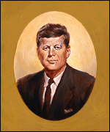
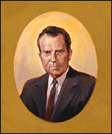
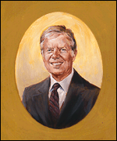
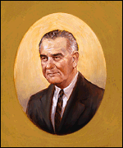
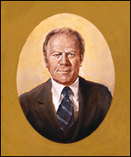
Objective: To examine the presidencies of Kennedy, Johnson, Nixon, Ford, and Carter.
John F. Kennedy 1961-1963
Jimmy Carter 1977-1981
Richard Nixon 1969-1974
Lyndon Johnson 1963-1969
Gerald Ford 1974-1977

Slide 2
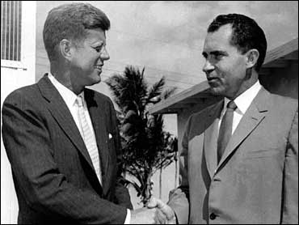
President John F. Kennedy
JFK – Election and Assassination:
View the debate, the first televised presidential debate in U.S. history.
· Democrat John F. Kennedy defeated the Republican Richard Nixon in the presidential election of 1960.
President-elect John F. Kennedy, left, shakes hands with Vice President Richard M. Nixon after a post-election conference in Miami, Nov. 14, 1960.

Slide 3
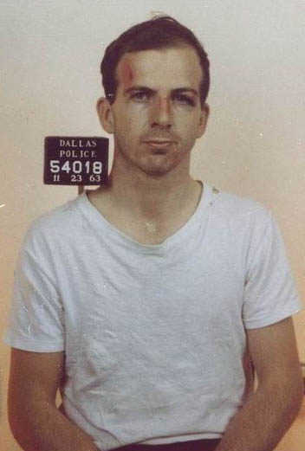
· In 1963, Pres. Kennedy was assassinated by Lee Harvey Oswald in Dallas, Texas.
Video: CBS News coverage of the assassination (2:52)

Slide 4
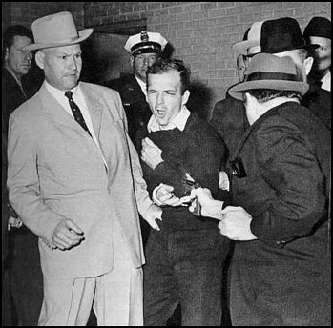
Jack Ruby, shot Lee Harvey Oswald on November 24th, 1963, as the Dallas Police was transferring Oswald to the county jail.
Video of Oswald’s Murder

Slide 5
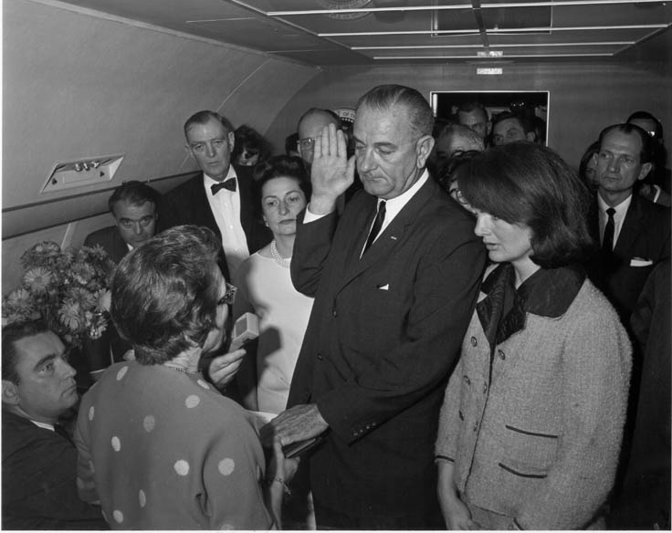
President Lyndon Johnson
· Vice-president Lyndon Johnson was named President upon the assassination of John F. Kennedy in 1963.
Lyndon B. Johnson takes the oath of office aboard Air Force One in Dallas, Texas, November 22, 1963.

Slide 6
· Pres. Johnson developed a series of new programs called the Great Society aimed at increasing the standard of living of Americans.
Great Society Programs:
- Medicare helped pay the hospital bills for citizens over the age of 65.
- Medicaid gave states money to help poor people pay for medical care.

Slide 7
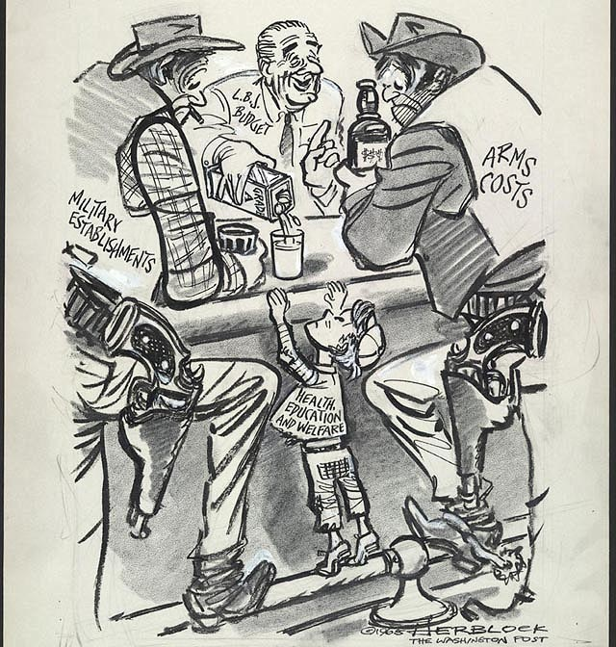
- The Economic Opportunity Act helped the poor by offering job training and loans.
- Congress created the Department of Housing and Urban Development (HUD) to build low-income housing.
---A 1965 Herblock Cartoon, copyright by The Herb Block Foundation
“Kindly Move Over A Little, Gentlemen”

Slide 8
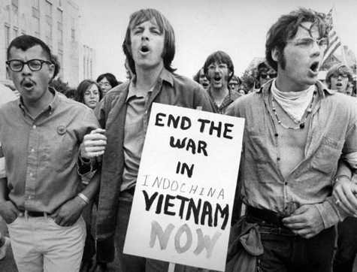
1968: Year of Crisis
· Americans protested against the Vietnam War across the country.

Slide 9
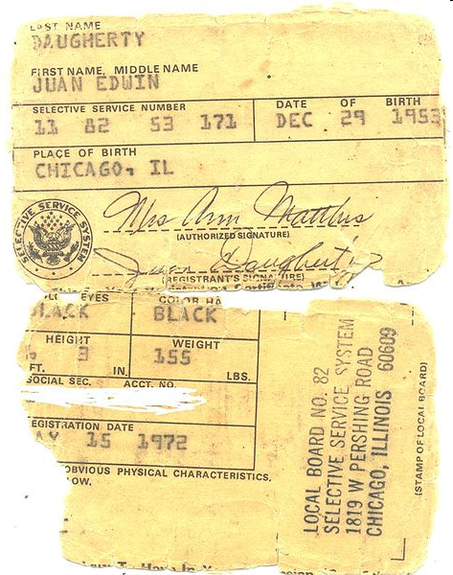
· Thousands of college students burned draft cards and refused to serve in the military.
Remains of ripped Vietnam War draft card. (1972)

Slide 10
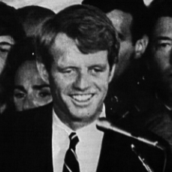
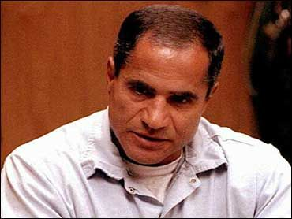
· Presidential candidate Senator Robert Kennedy was assassinated.
Sirhan Sirhan, convicted killer of Robert Kennedy, in a 1997 photo.
Robert F. Kennedy

Slide 11
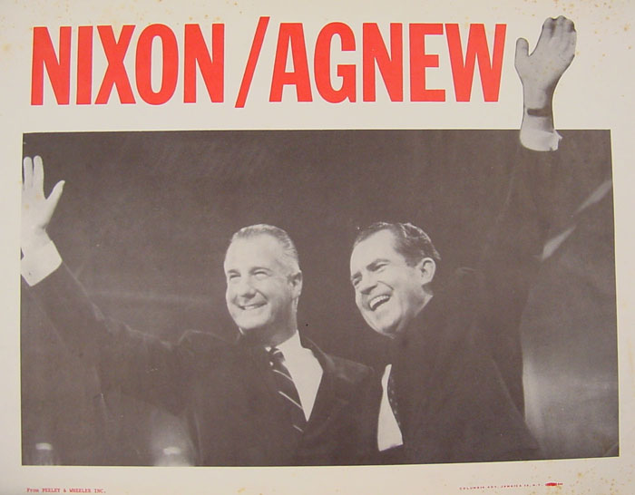
Election of 1968:
· Republican Richard Nixon defeated Democrat Hubert Humphrey.

Slide 12
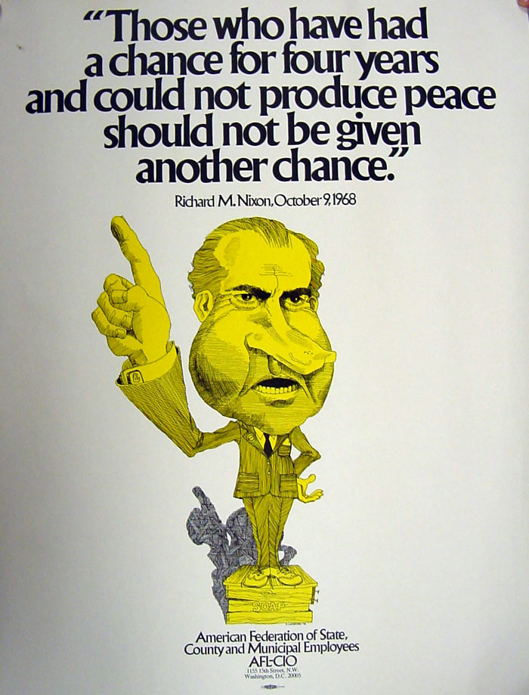
Richard Nixon as President
· Pres. Nixon opposed parts of the Great Society programs and cut funds for job training, low-income housing and education.

Slide 13
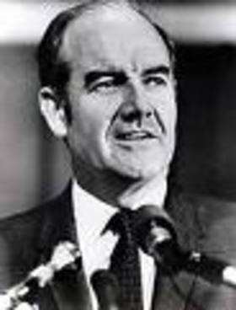
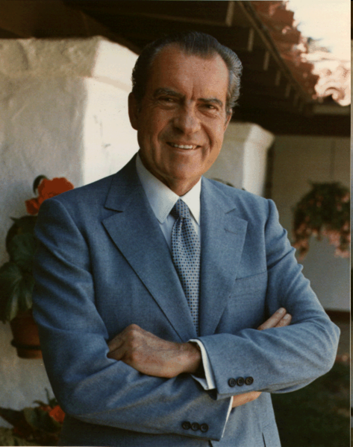
· Nixon easily defeated Democratic Senator George McGovern to win reelection in 1972.
George McGovern
Richard Nixon

Slide 14
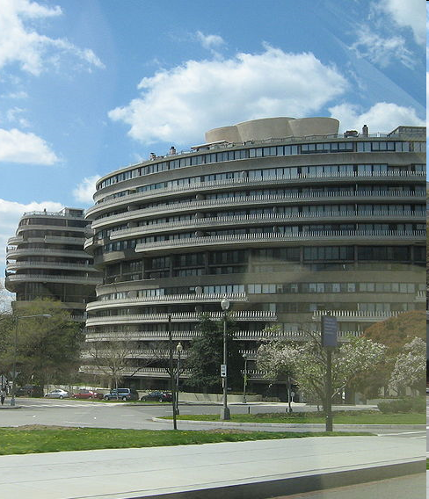
The Watergate Affair: In June of 1972, police caught five men breaking into the Democratic headquarters in the Watergate apartment building in Washington, D.C.
· The burglars were linked to Nixon’s reelection committee, but Nixon said that he was not involved in the scandal.
Video: Pres. Nixon defends his office on Watergate charges
Watergate Hotel

Slide 15
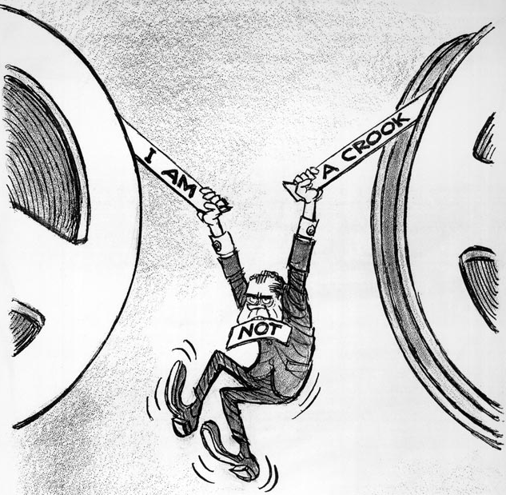
· However, Nixon made secret tapes of all conversations in his office, in which he was caught on tape talking about trying to cover up the Watergate break-in.
---A 1974 Herblock Cartoon, copyright by The Herb Block Foundation

Slide 16
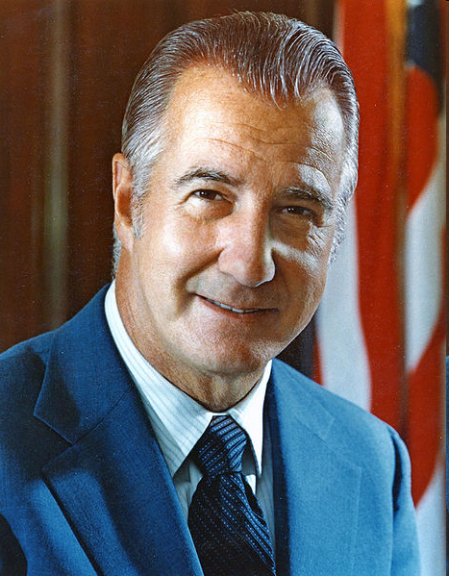
· In the meantime, Vice President Spiro Agnew was accused of taking bribes and was forced to resign.

Slide 17
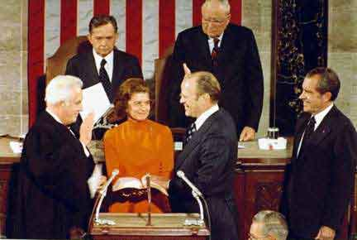
· Pres. Nixon then assigned Representative Gerald Ford as his new Vice-President.

Slide 18
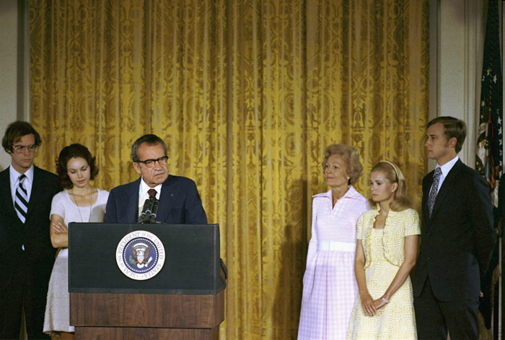
· In 1974, the House of Representatives passed three articles of impeachment against Nixon, including obstructing justice.
· In August of 1974, Nixon resigned from office rather than go through an impeachment trial.
Video: Resignation and Summation (2:55)
President Richard Nixon delivers remarks to the White House staff on his final day in office. From left to right are David Eisenhower, Julie Nixon Eisenhower, the president, First Lady Pat Nixon, Tricia Nixon Cox, and Ed Cox. (August 9, 1974)

Slide 19
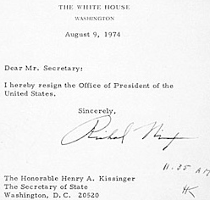

Slide 20
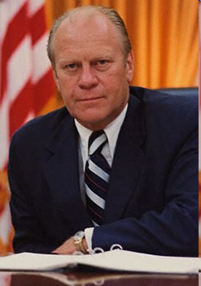
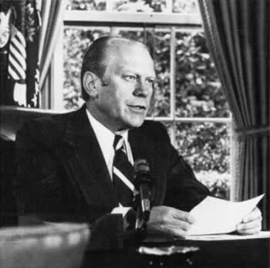
A Time to Heal
Vice-President Ford was named President upon Nixon’s resignation.
Pres. Ford then granted Nixon a “full, free and absolute pardon”.
Video: Ford Pardons Nixon - September 8, 1974 (9:34)

Slide 21
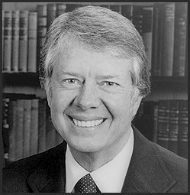
Ford lost a close race for reelection in 1976 to the Democrat Jimmy Carter.

