Slide 1
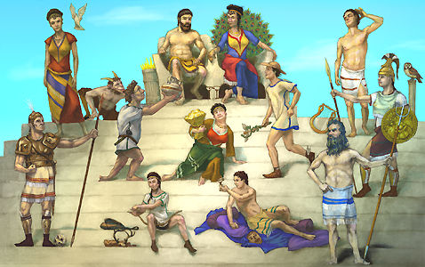
Image #4
1. These are known as the twelve major gods.
2. They are standing on Mount Olympus
3. The gods shown are Zeus,Hera,Poseidon,Demeter,Athena,Apollo,Artemis,Ares,Aphrodite,Hephaestus,Hermes,andDionysus.
4. Zeus is the supreme god of the Olympians.
5. The gods meet in council in the Homeric epic, but the first ancient reference to religious ceremonies for the Olympians collectivity is found in Homeric Hymn to Hermes.

