Slide 1
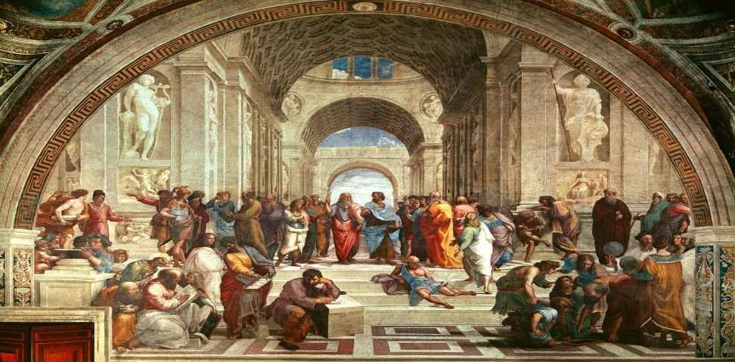
Image # 18
1. This was set in the early 1500’s.
2. It features the best mathematicians, philosophers, and scientist from all different time periods.
3. The famous painter Raphael painted this and featured a self-portrait with in it.
4. This painting was also set in Rome, Italy.
5. The most important people in the painting are: Pluto, Diogenes, Euclid, Zoroaster, Ptolemy, Pythagoras, Aristotle, Socrates, Alexander the Great, and Epicurus.
Notes:
,

